Slide 1
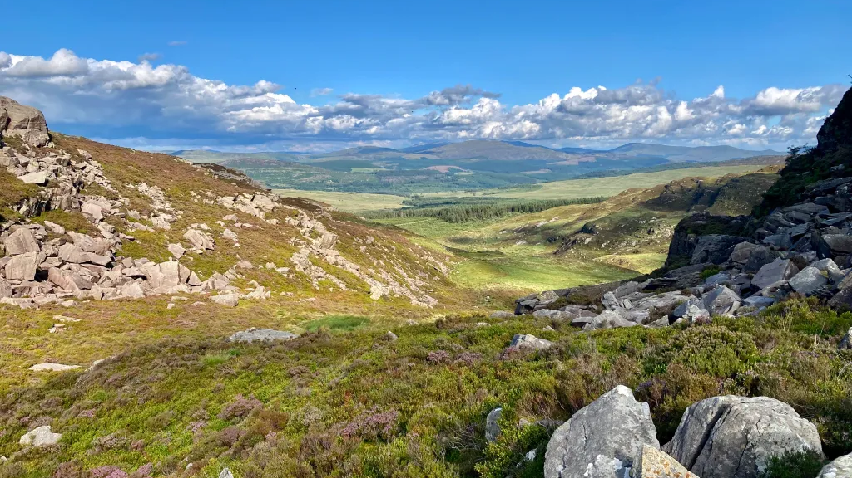
Gold Walking Expedition to the Outdoors!

Slide 2

Why walk?
Adventure, nature, challenge, cost.
Your group will collectively choose the level of adventure / challenge to take on.
This could be the most physically challenging thing you do in life (it’s not a small thing), or it could be the start of lots more!
Depending on your expedition aim, and balance between journeying and exploring, you could focus on walking as far and fast as possible, or finding the best places and exploring nature, or any mix of them.
It’s just a bonus that it’s the cheaper of the 2 options on offer.
Our initial plan is to take you to the Peak District, North Wales (south Eryri (Snowdonia)), and the Lake District.
If you wild camp, and get lucky…

Slide 3
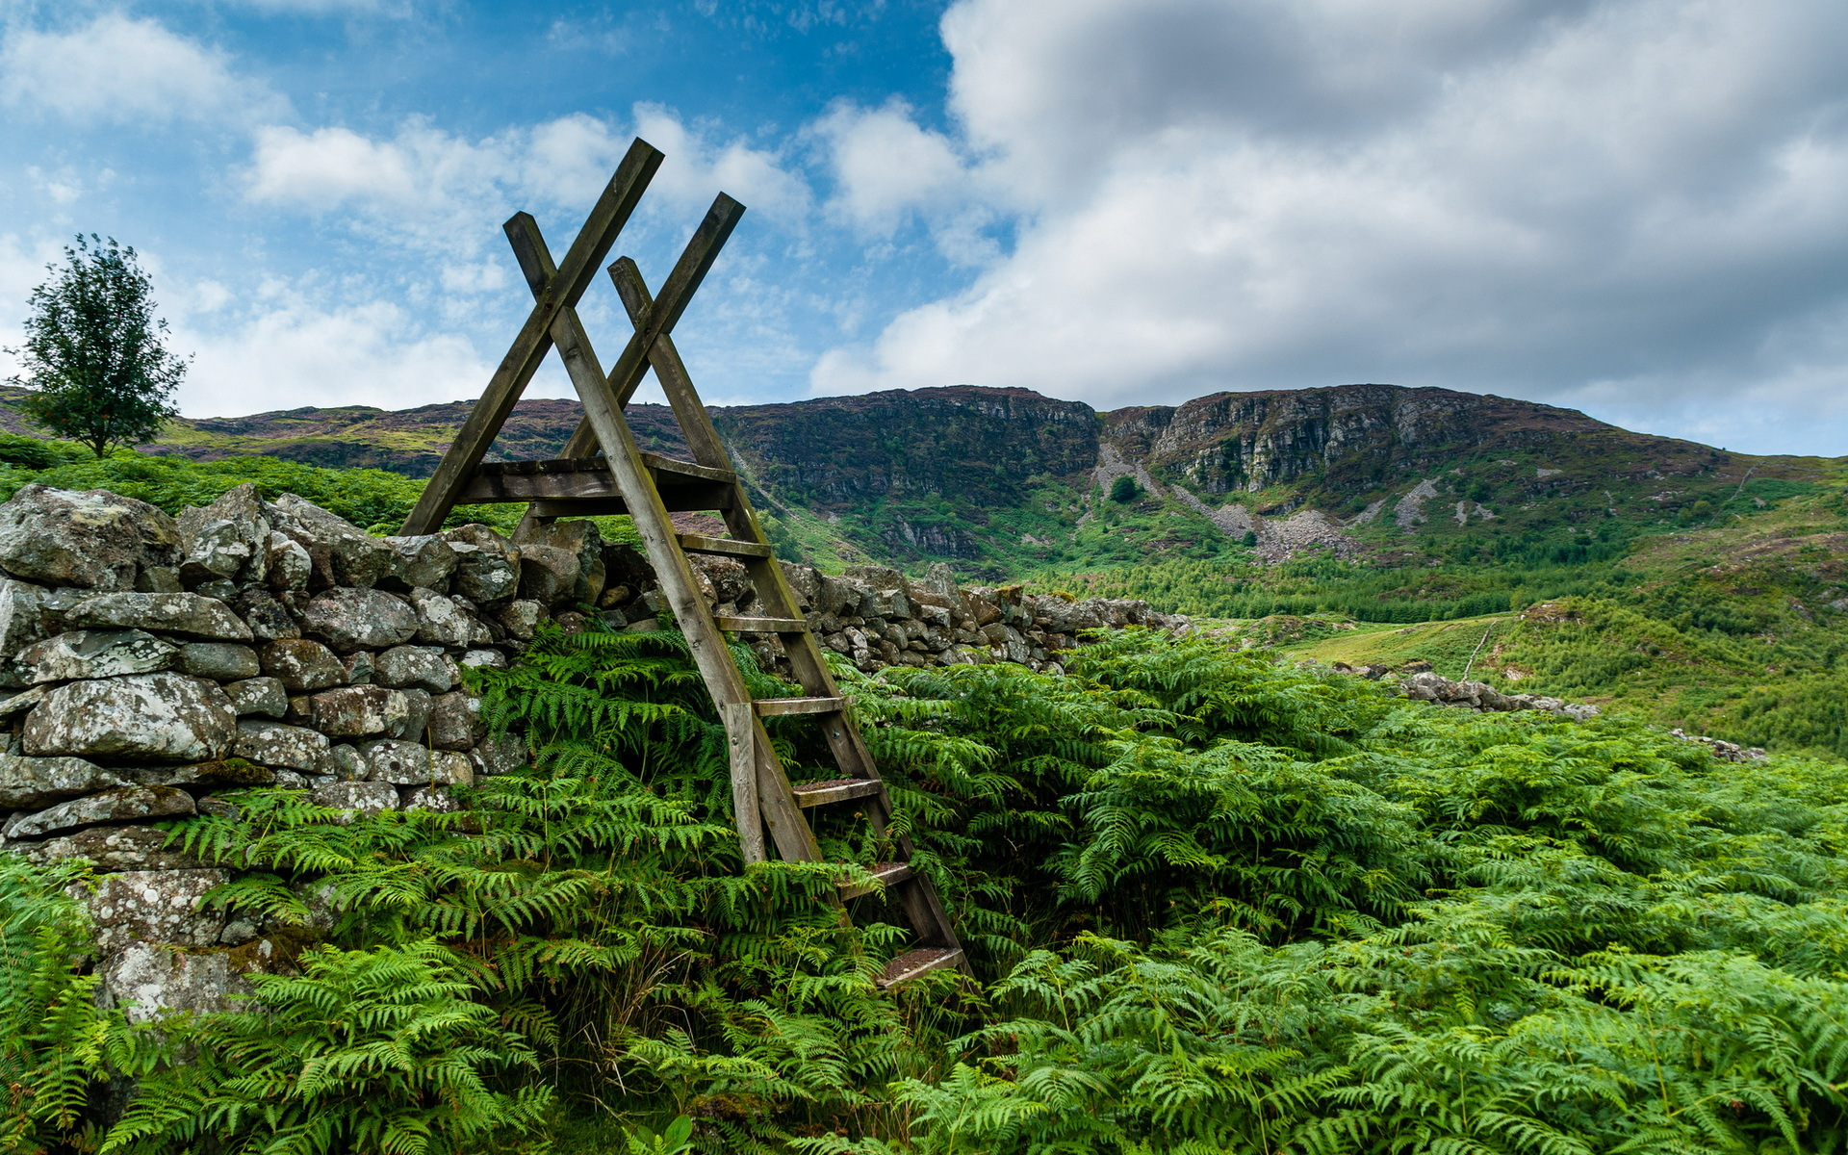
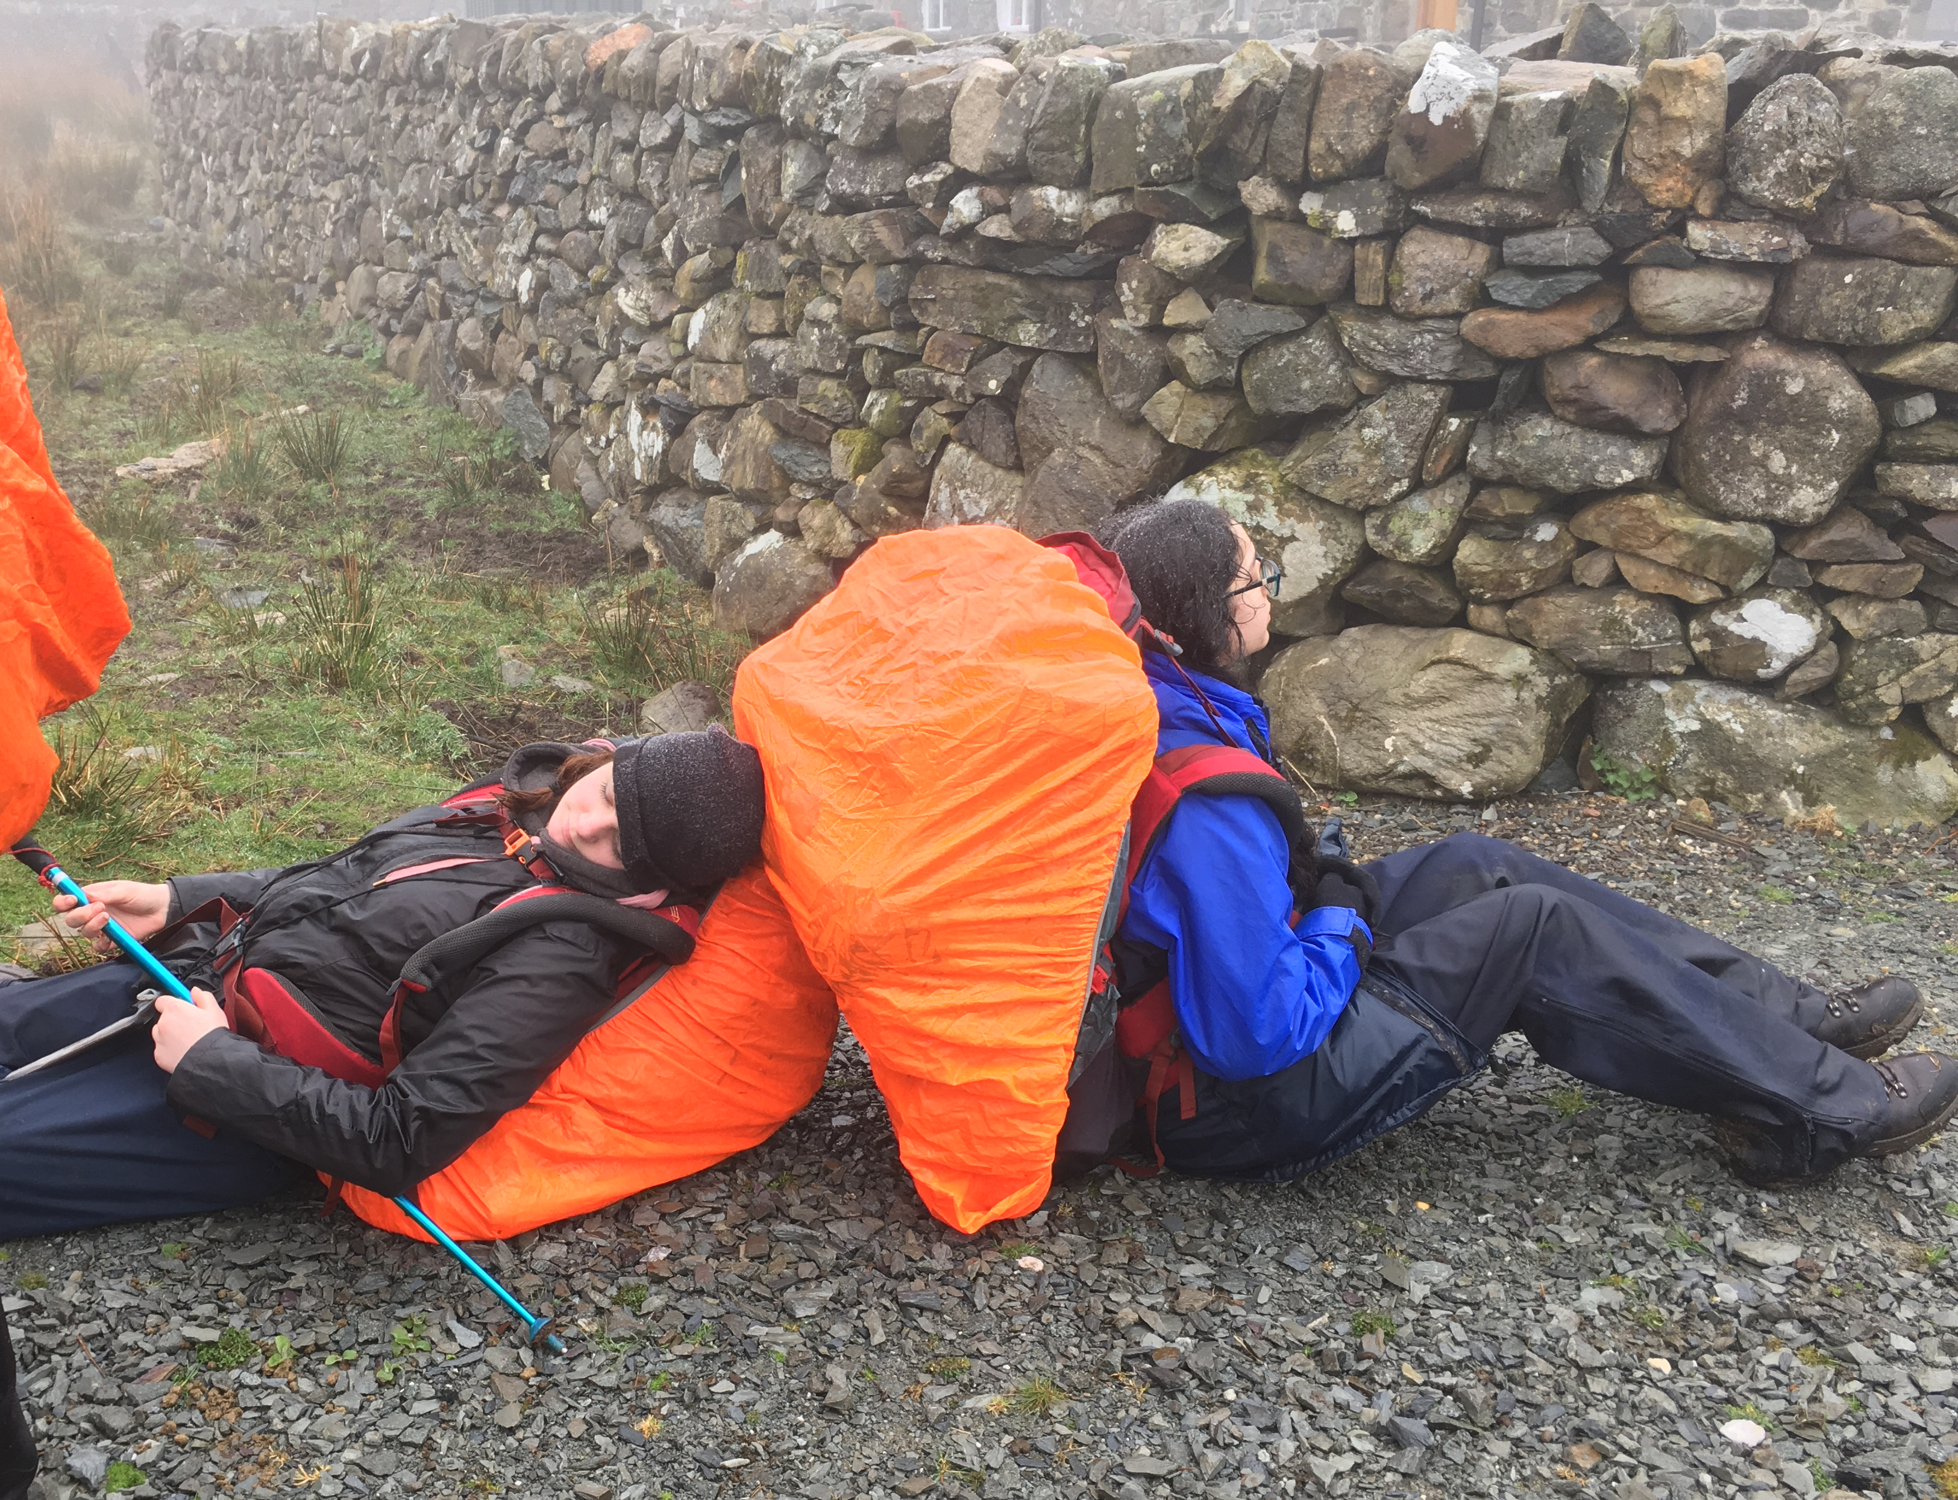
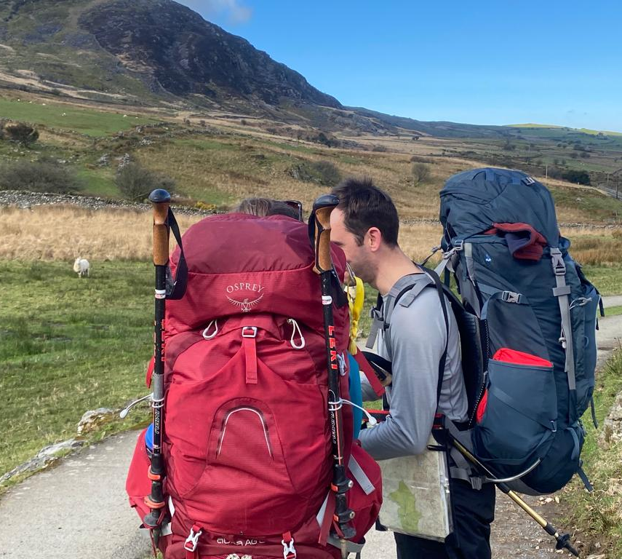
Expeditions in D of E
At Queens Road D of E we have run expeditions for the last 30 years+, organised and led by qualified outdoor leaders (inc First Aid).
Most of you will have done a walking expedition with us already, and if you haven’t, that’s not a problem, but gold is a step up.
We usually go to “Wild Country”, and that means that you need to be that much more ready.
What is needed?
Commitment, willingness to learn, a degree of fitness, team work and personal responsibility. We meet on Friday evenings of term time to learn and improve the skills needed.
You might need to navigate off a foggy hill, or put a tent up in the dark, or cook food that you’re willing to eat for 4 days in a row, or look after a friend who’s hurt themselves…
Don’t have kit? We can loan it to you.
Don’t know anything? We like teaching.
Cost?
In total it will be about £300. That’s spread over the year, encompassing; a 2 day training weekend, 1 navigation day, a 4 day practice and a 6 day final expedition.

Slide 4
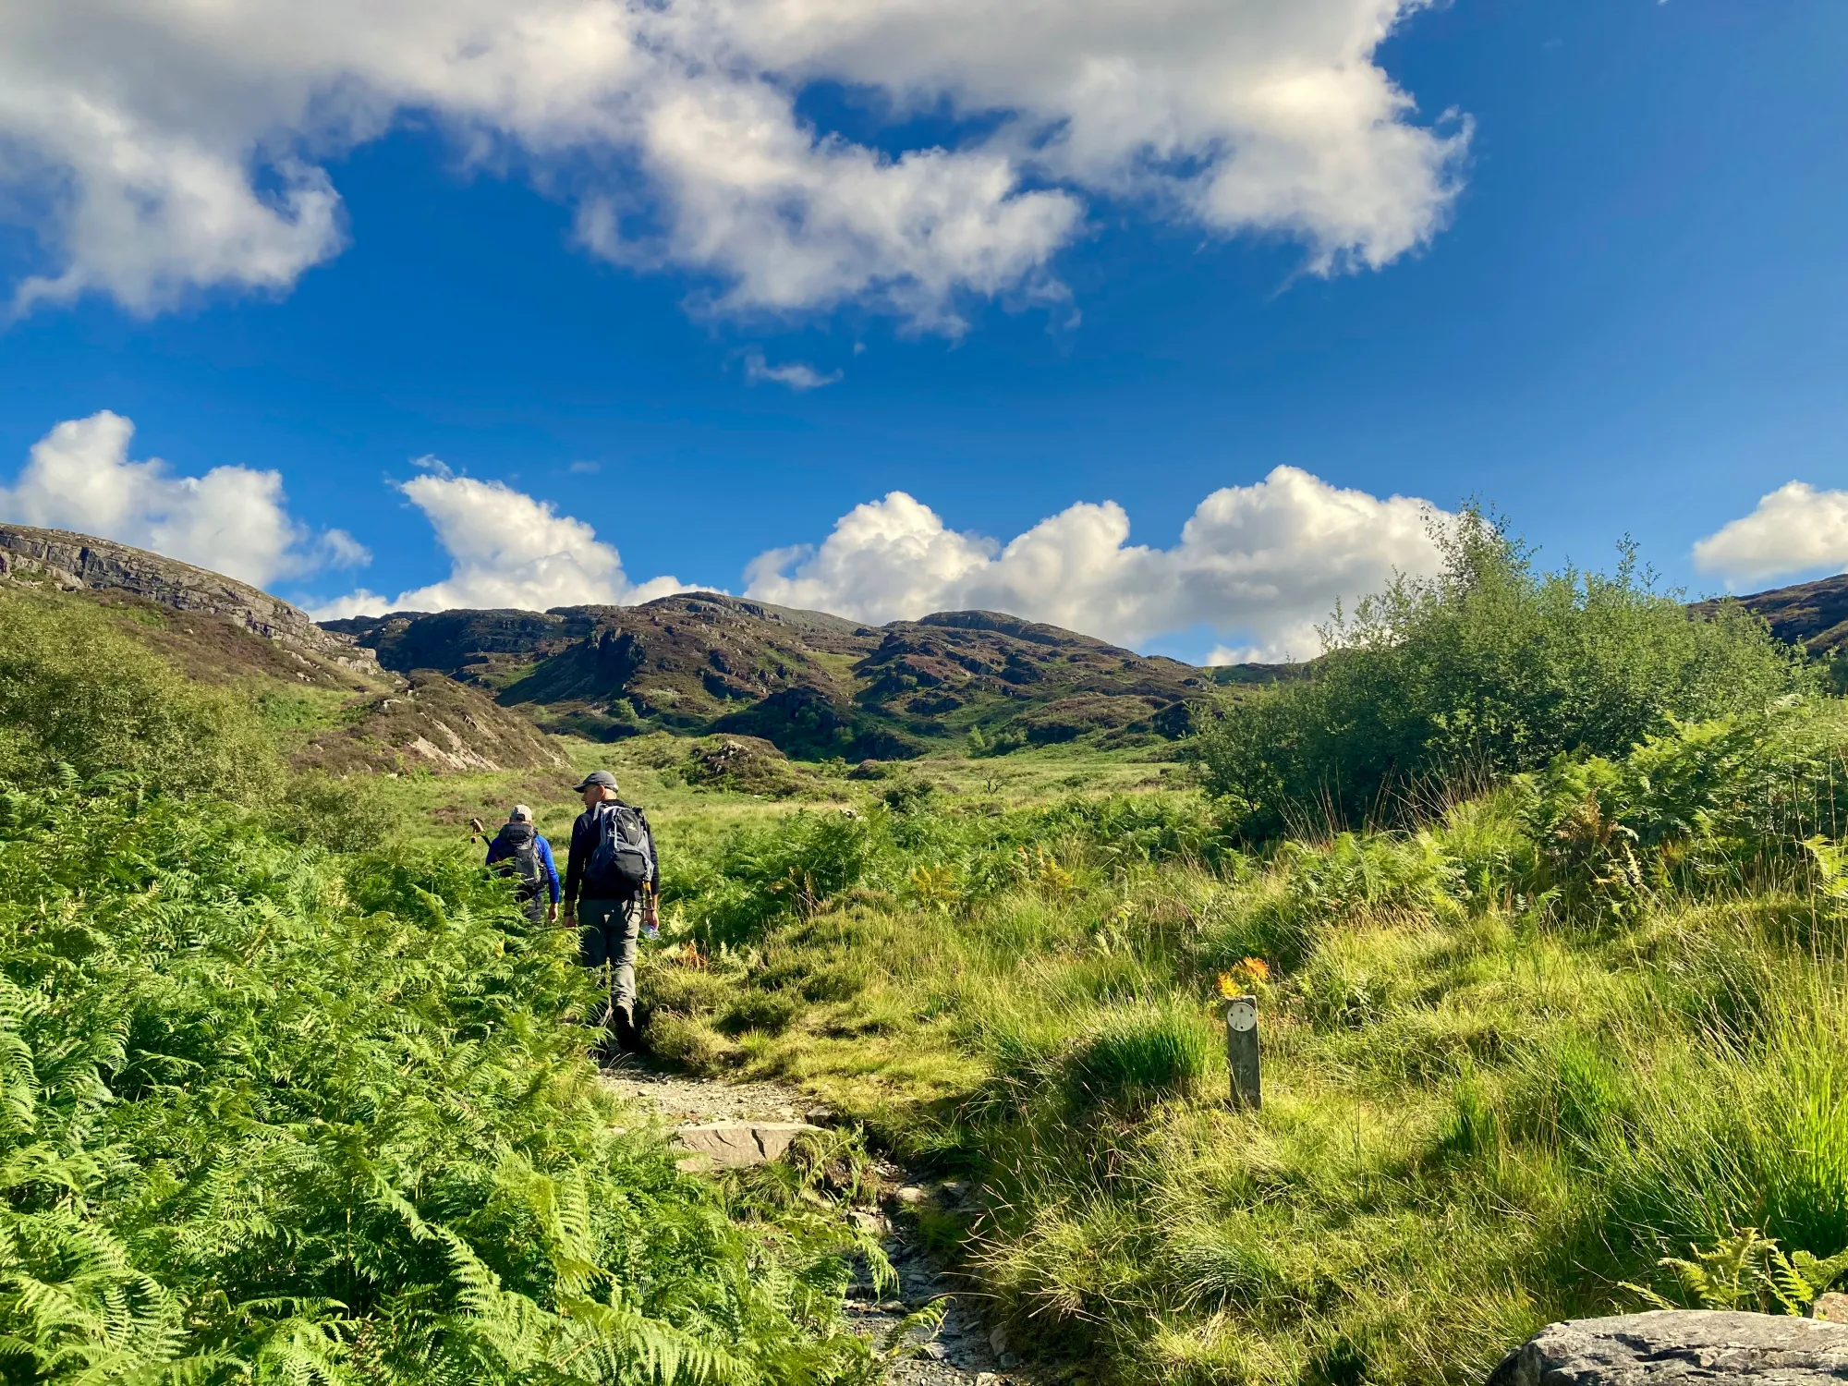
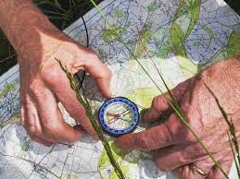
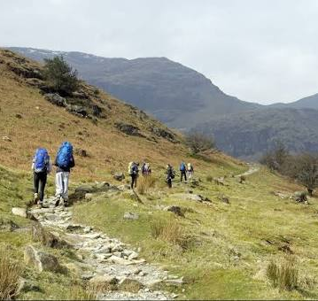
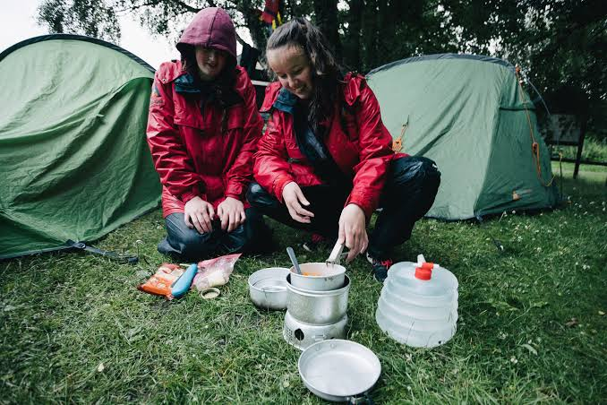
The commitment you need to make...
We will start training for the gold expedition 2027 in September 2026. We need to sign you off as “competent” before letting you loose on the Practice, so we ask that you plan on being with us nearly every term-time Friday.
Throughout the Autumn and Spring terms we will be learning all the things needed, in a more relaxed and hopefully fun way.
We’ll be having a “Master chef challenge”, and Camp kit “Supermarket sweep”, and probably a small (walking) orienteering challenge in Spencer Park (5min from QRBC).
We’ll do an initial taster / intro trip on Sat 3rd & Sun 4th October, our Nav Day will be Sun 21st March, and then Easter will be when we do the Practice Expedition, Thurs 1st to Sun 4th April.
From Easter we’ll plan the Final, and then have a break around exams, before we go on the Exp, on Tues 27th July to 1st Aug

Slide 5
Proposed dates
Book these on family calendars and in your phone now please, so pesky parents don’t organise family holidays without consulting you...
Training Weekend: Sat 3rd & Sun 4th October 2026
Navigation Day: Sun 21st March 2027
Practice expedition: Thursday 9th- Sunday 11th April 2027
Final expedition: Thursday 19th – Thursday 26th August 2027

