Slide 1
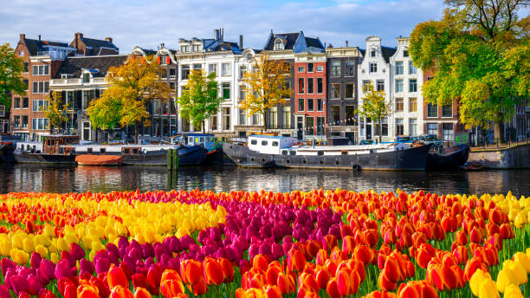
Gold Cycling Expedition to the Netherlands
Last week of the summer holidays, 2027,(exact dates to be confirmed.)

Slide 2
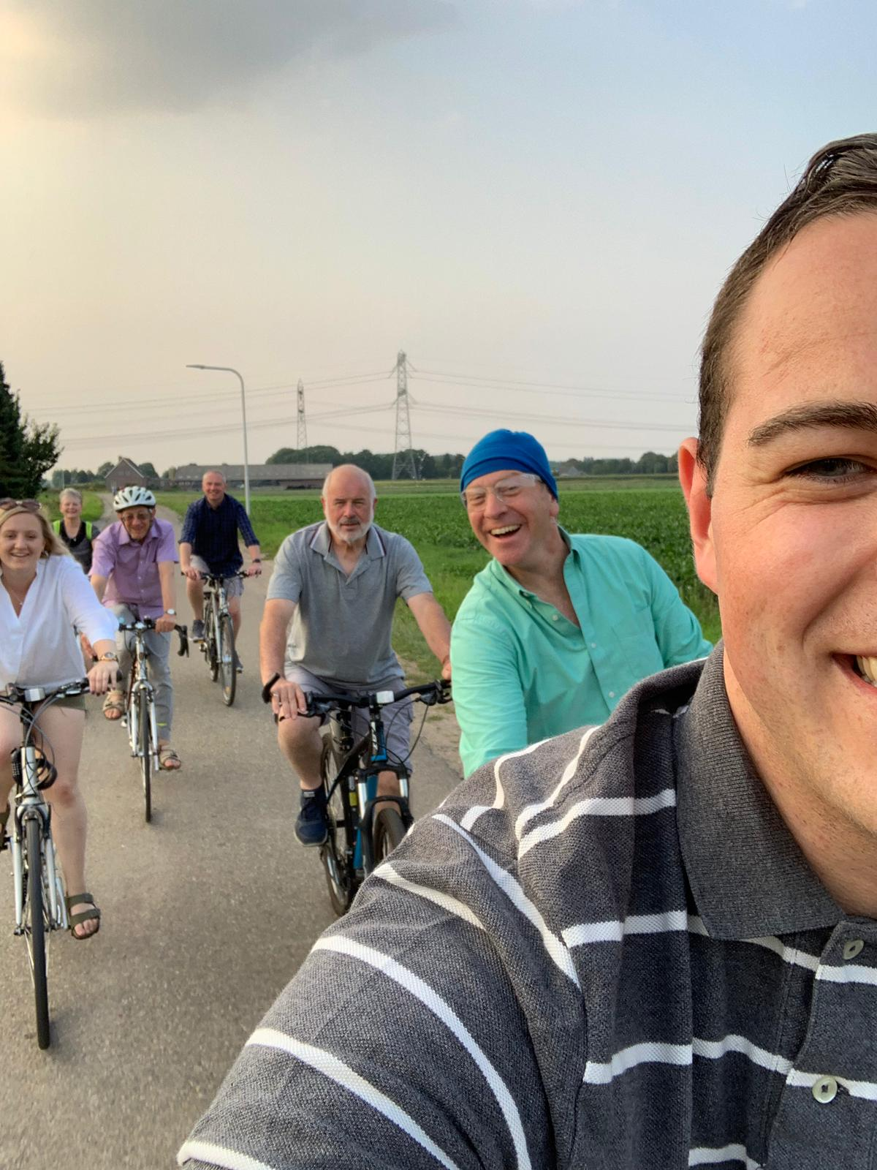
Why cycle?
Cycling is one of the best ways to travel. It has low impact on the body and environment but is great for health and longevity.
Many people worry about safety on bikes, but with increasing cycling infrastructure, good training and careful planning of routes, cycling regularly is a great lifestyle to adopt.
By visiting the Netherlands for the final expedition, we will be going to the best place on Earth for cycling.
Some of your leaders cycling in Holland – no traffic and lycra free.

Slide 3
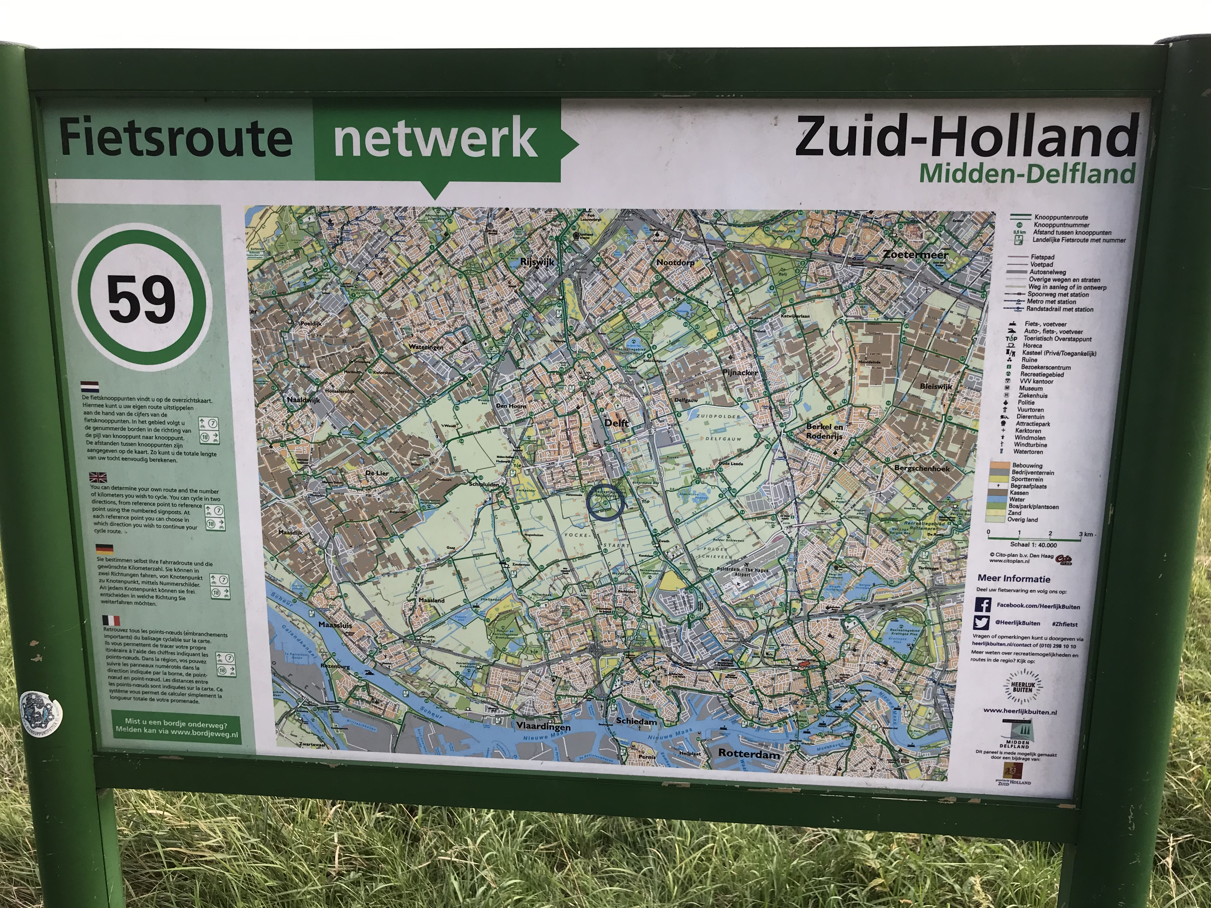
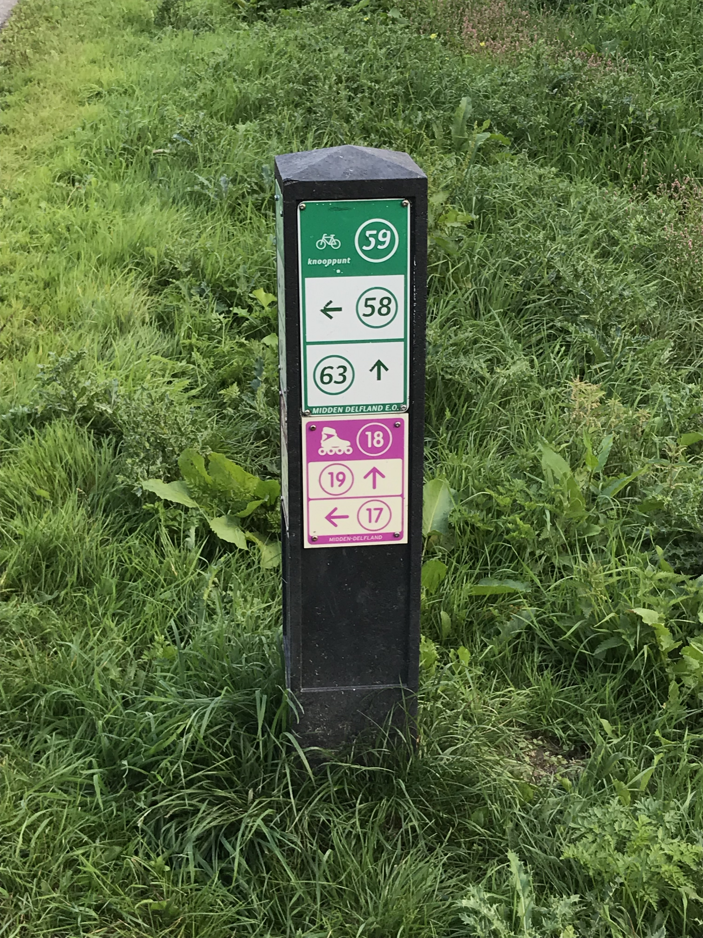
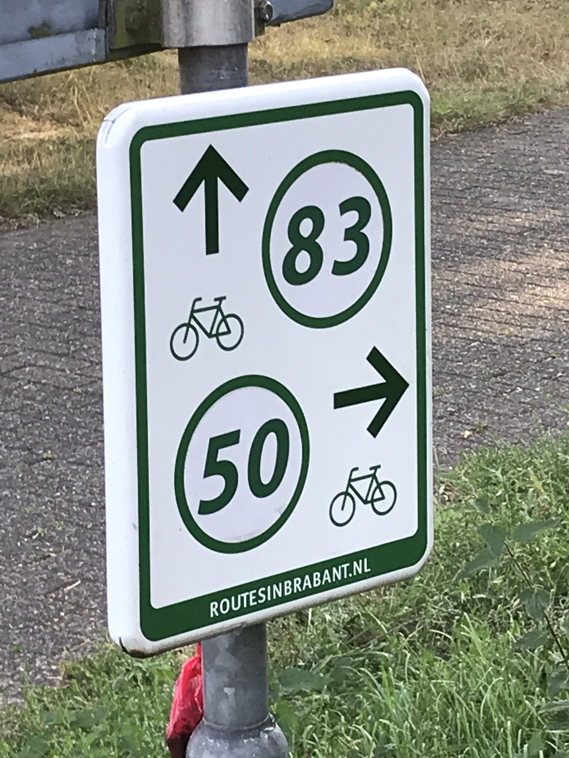
Cycling Expeditions in DofE
At Queens Road DofE we have run cycling expeditions for the last 16 years, organised and led by qualified ride leaders and two National Standard Cycling Instructors.
Cycling for this element of the award provides a very different experience to the walking style expedition. It also requires quite different skill sets, not least the ability to cycle safely on the road.
What is needed?
Commitment, training and a desire to work as part of a team. We meet on Friday evenings of term time to learn the skills needed to service a bike, and to train for the expeditions.
Don’t know how to ride a bike? We can teach you.
Don’t have a bike? We can lend you one.
Need to borrow panniers and a rack? We can provide these too!
If you want to cycle your own bike, it needs to be a hard tail bike that can have a rack fitted to it.
The Fietsknoop network signs in the Netherlands.
Cost?
It is more expensive than the walking option. In total it will be about £600. That includes a 4 day practice and a 7 day final expedition.
We travel to the Netherlands by car and ferry for the final expedition and we will cover the cost by taking monthly payments of up to £60 over 10 months.

Slide 4
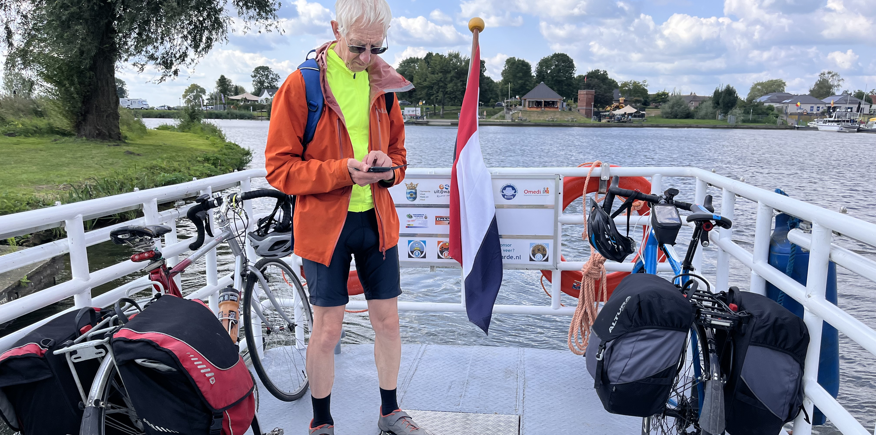
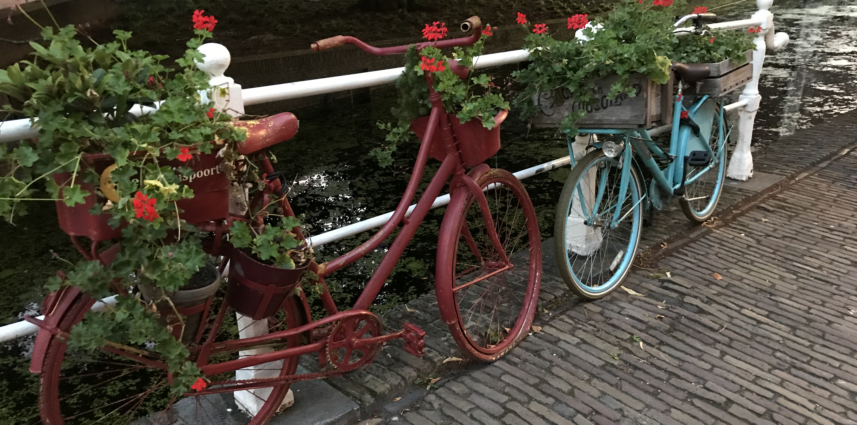
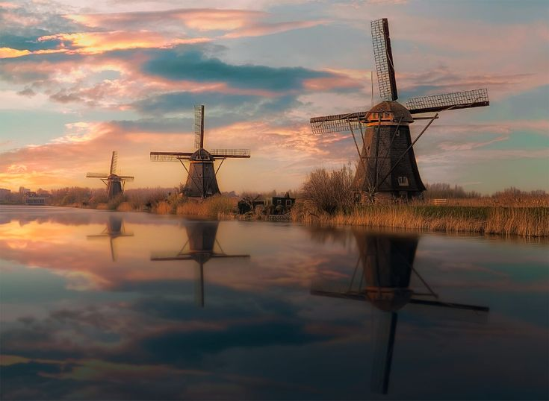
The commitment you need to make...
We will start training for the gold cycling expedition 2027 in September 2026.
Throughout the Autumn and Spring terms we will learn how to maintain and service bikes, how to cycle safely on the road and do safety and navigation rides. This can count as your skill section of your gold award.
Easter will be when we do the practice expedition. By then we need to be assured you are safe on the road, can ride 30-40 miles in a day and have completed all the safety elements of your training.
From Easter to the start of the summer holidays we will be out riding regularly on Friday evenings to build the miles in your legs and complete skills challenges.

Slide 5
Proposed dates
Book these on family calendars now please, so parents don’t organise family holidays without consulting you...
Practice expedition: Thursday 9th- Sunday 11th April 2027
Final expedition: Thursday 19th – Thursday 26th August 2027

